Slide 1

Funded Projects
- Knowing the Probability is Helpful-
By Benson Chen, August 07, 2019

Slide 2



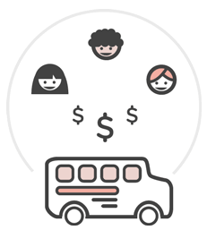
DonorsChoose Business Model: Simple But Powerful
Donors:
Find projects that they want to support
Option of allocate 15% donation to DonorsChoose
Teachers:
Thank you letter to donors
Report on how each dollar was spent.
Teachers:
Post a classroom project with wanted items
DonorsChoose:
Fulfill the order if a project is fully funded
Our goal is to build some useful tools to improve the process using the prediction of which projects will be funded.
Notes:
This is a project is based on donation data from DonorChoose. This shows the business model of the organization. DonorsChoose provides an online platform, teachers post what they need for a classroom project. Donors choose the project that they like and donate. The organization rely on the 15% allocation to run. If a project is funded, donorsChoose will make the order and have it ship to school. Teachers have to report on how each dollar was spent.
Our goal is to build some useful tools to improve the process based on predicting which projects will be funded.

Slide 3
Classification Project workflow
Business Application
With the final model, build business applications aim to add value to the organization.
Modeling
Preliminary model selections
Choose the best model useful in business application.
Data Collection and
EDA
Dataset is available in Kaggle
Perform EDA
Hypothesis
Probability of a project being fully funded have is valuable to the organization.
Notes:
This is the process of my project. I assume classification model is valuable to the organization. I download the data from Kaggle and Perform EDA. Then move on to modeling and building business application.

Slide 4
Modeling Process
Initial Model Selection
Logistic Regression and Gradient Boosting Machines stand Out
Feature Engineering
Add more related categorical features
Convert ‘Project Essay’ feature to word counts
Final Model Selection
Logistic Regression and GBM models have close scores
Logistic Regression is picked due to its simplicity and interpretability
Finalize Model
Optimize and standardize Model
Interpret the coefficients of the features
EDA
Notes:
Here is my modeling process in detail. Logistic Regression and GBM give me the best result. Then I did add more categorial feature and convert essay columns to word counts and use it as a feature. Finally, I pick Logistic Regression because it is simple and interpretable. After that I standardize data for coefficients comparison.

Slide 5
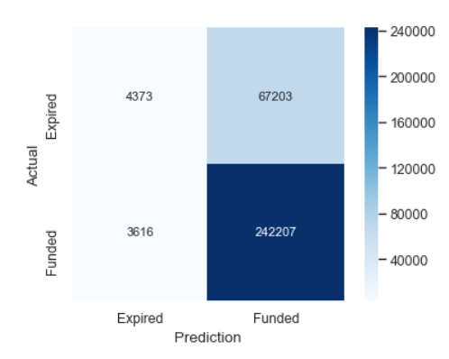
Logistic Regression Model Information
Confusion Matrix
Data information
Test Data
Sample size: 1,057,995
(2013 – 2018)
Features: 40
Labels: {Funded : 1 , Expired : 0}
Labels proportion:
{Funded : 77% , Expired : 23%}
Test sample size: 317,399
Model Scores at 50% Threshold
Important Features
Accuracy : 0.777
Precision: 0.783
Recall : 0.985
F1_score : 0.872
Features | Coeff
Project Cost | -0.60
Essay word counts | 0.08
Technology Items | -0.24
Notes:
This is the information and result of my model. Over 1 million samples, 4o features, funded project is the positive class. Here is the scores on the test data. For features, higher project cost lower the chance of being funded. Word counts matter and do not ask for too many tech items like iPad.

Slide 6
Business Applications for
internal and external users
Teachers
Marketing
Finance/
Accounting
Fulfillment
Prediction Apps
Probability Feature
Prediction Dashboard
Prediction Dashboard
Suggestion to Teachers on getting higher chances of being funded
Use probability as a decision making factor
For budgeting
For cash flow management
For workload planning
For human resource management
Notes:
This is some useful business application. They all based on the prediction of the model. Web app for teachers and dashboard for internal department.

Slide 7
Web App for Teachers:
Teacher Chen’s Example
Input by teacher
Output by Web App
Improvement
Teacher Mr. Benson from Bensonhurst Elementary School make a project request of 10 apple iPads.
Web app calculate the odd of success
20% chances of being funded, here is what can be improve:
Lower the Project Cost of $3,399
Decrease the quantity of Technology items
Work on your project essay, we recommend at least 150 words and you have 15
Mr. Benson revise his request:
2 apple iPads
20 Little House on the Prairie
Essay word count: 324
Total Cost: $999
Web App Predict:
85% being funded
Notes:
The app is not ready. I can give an idea what it looks like. Mr.Benson from Bensonhurst Elementary school make a project request for 10 iPad. Web app predict he has 20% to be funded and give him some advice on how to get better. Lower the project cost, decrease the quantity of iPad. Write essay that have 150 word at least. After Benson revise his request, he got 85% chance.

Slide 8
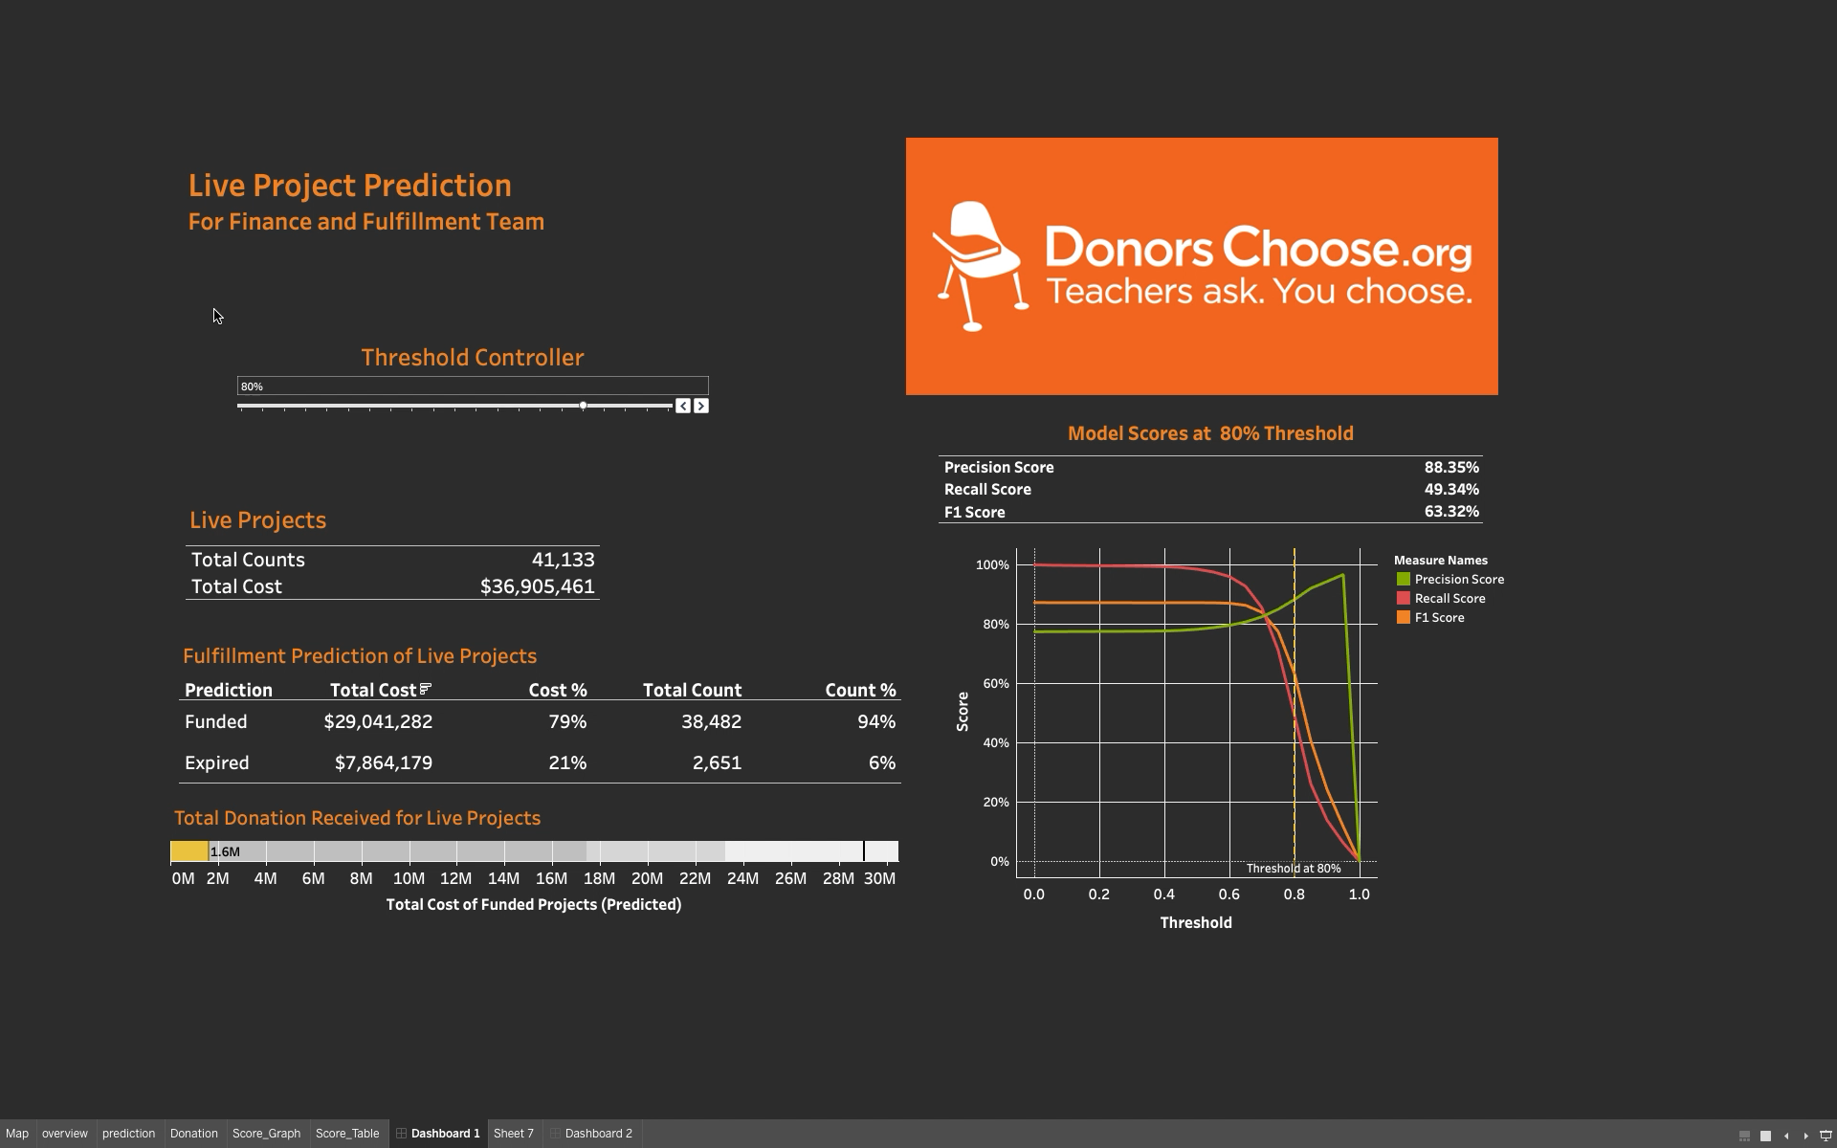
Notes:
Move to internal application. This is a dashboard I made for the finance and fulfillment team. It show the cost and count of the live project. The prediction of how many would be funded and total cost. The number will change based on the threshold. It gives the finance team cost information help them with budgeting and cashflow management. You are expecting to fufill $$$ of order. It also gives the fulfillment team a predicted work load, they now know how many fulfillment requests are coming.

Slide 9
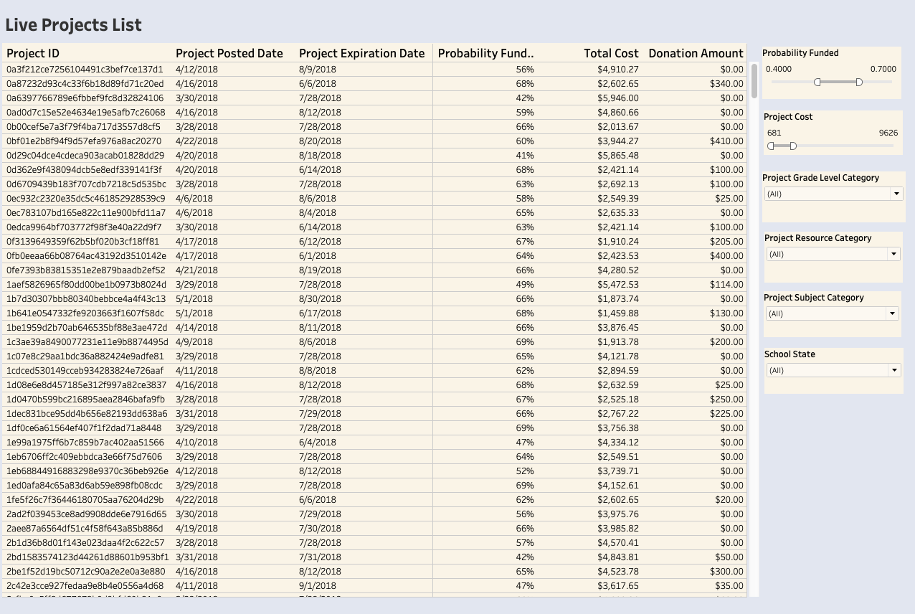
Marketing Team Dashboard
Notes:
This is a dashboard for the marketing team. They should already have something similar. I added a Probability Columns for them, they can use probability to decide whether promote that project. It may make their life easier or more difficult because they have one more thing to worry about.

Slide 10
Thank you

